Slide 1
Rock Cycle processes

Slide 2
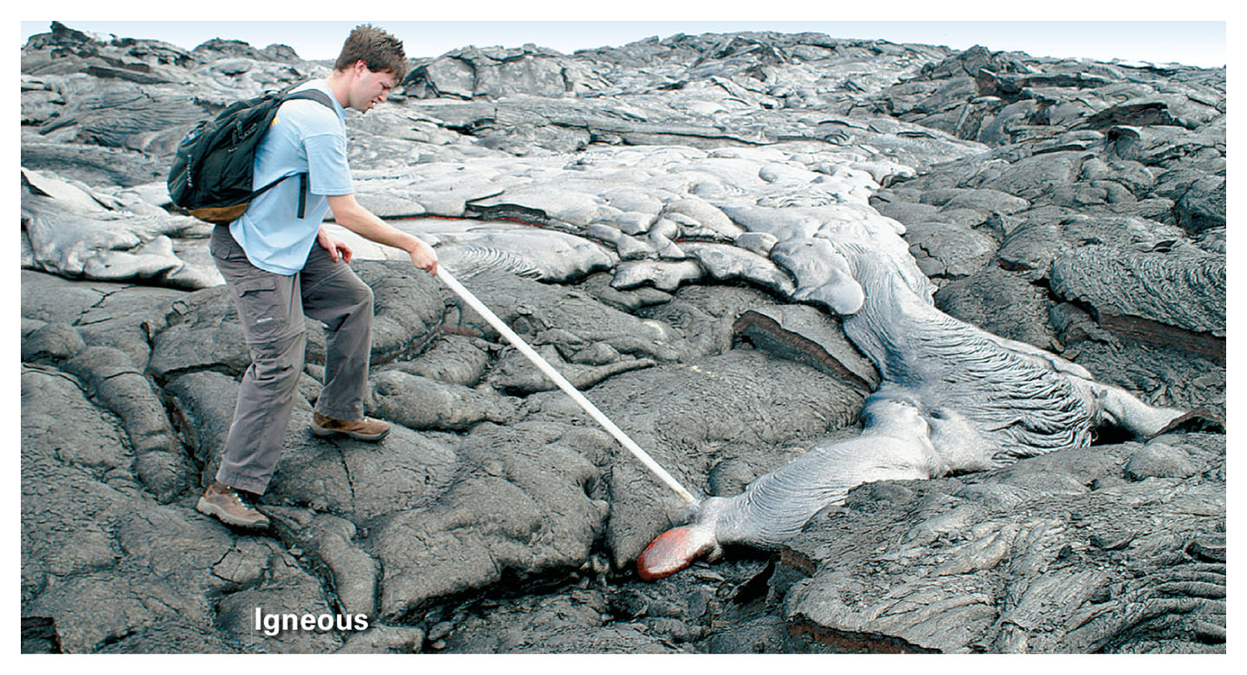
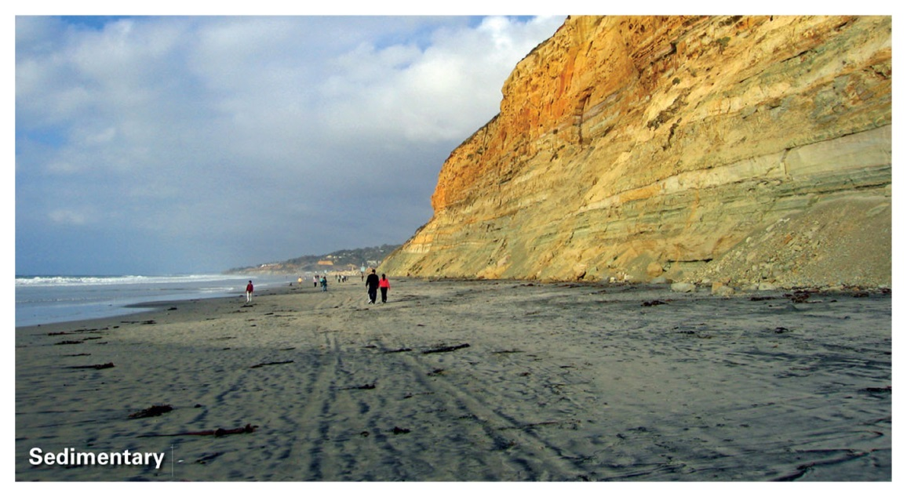
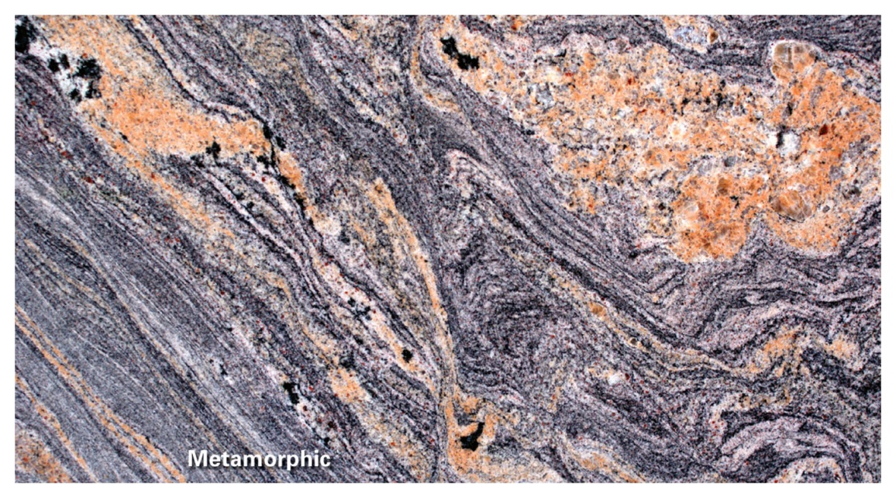
Igneous
Sedimentary
Metamorphic

Slide 3
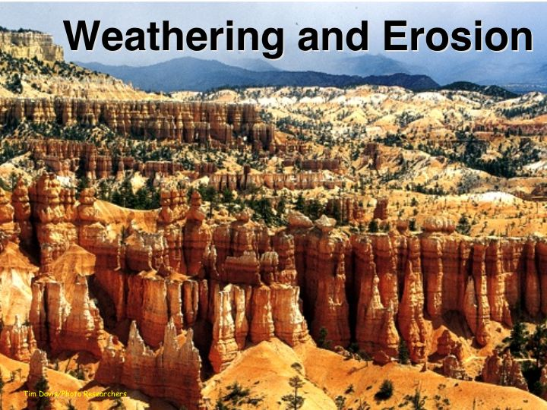
Rocks can be weathered and eroded

Slide 4
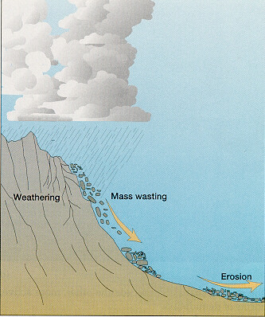
Weathering – the breakdown of rocks by chemical and mechanical processes
Erosion – the transport of material by mobile agents such as water, wind, ice, or gravity

Slide 5
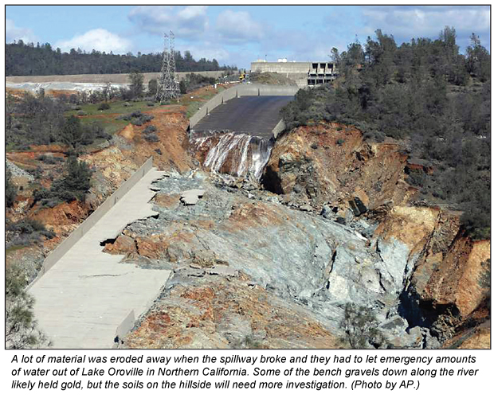
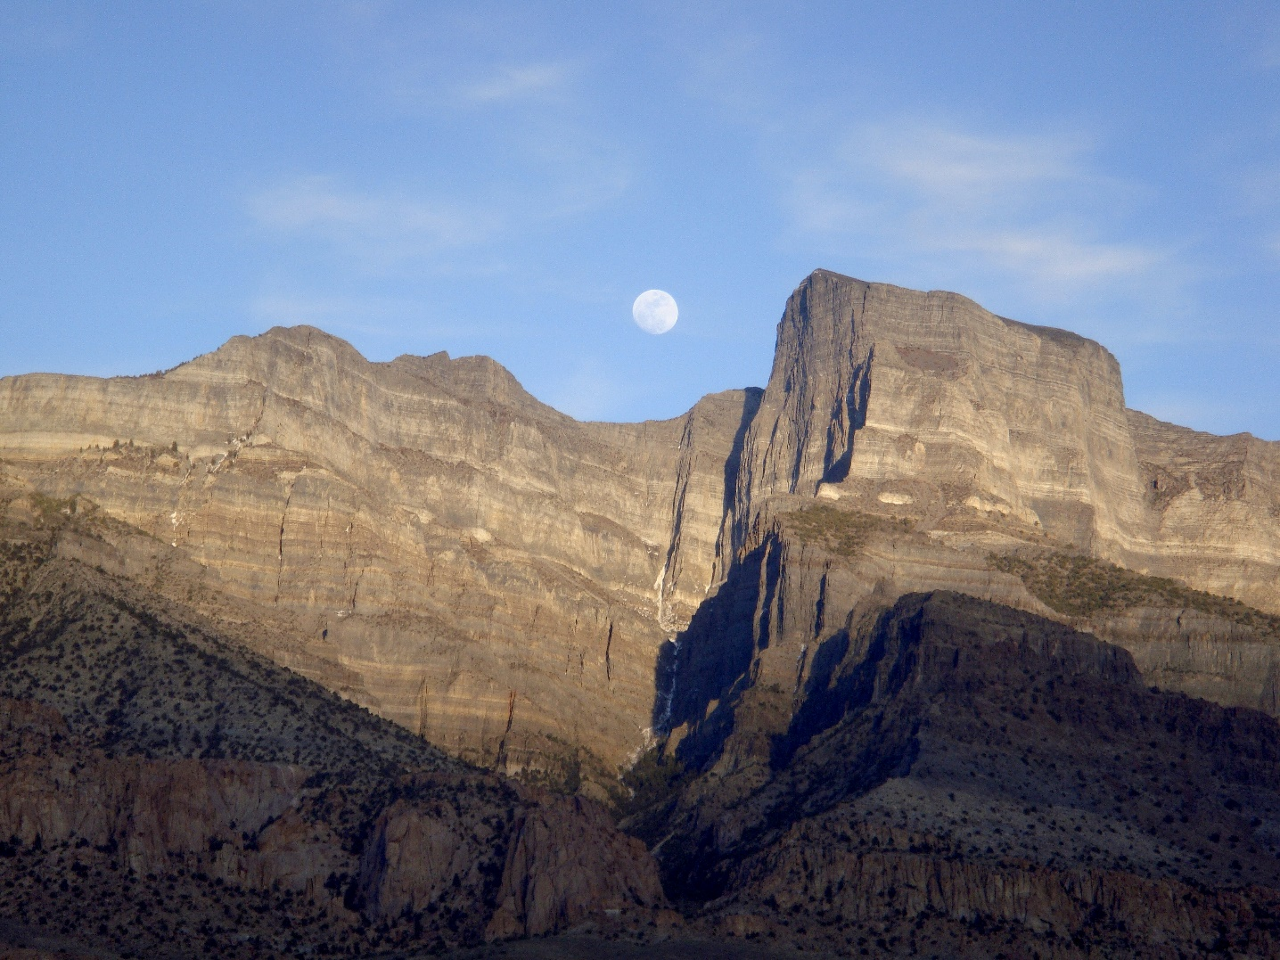

Slide 6
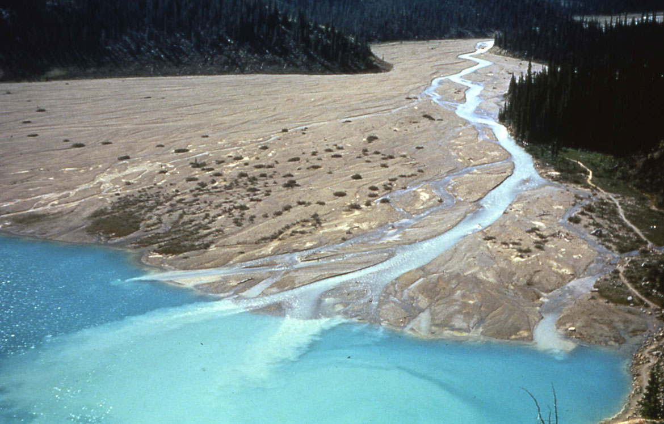
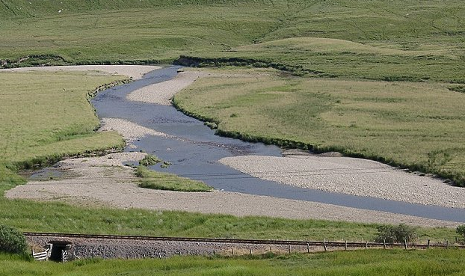
Sediments can be transported and deposited

Slide 7
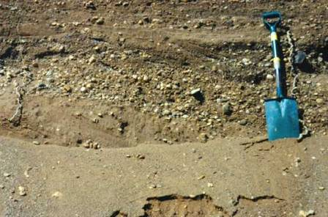
After deposition, sediments can be buried and lithified
Lithification – process of turning unconsolidated sediment into a solid sedimentary rock
Usually by cementing sediment

Slide 8
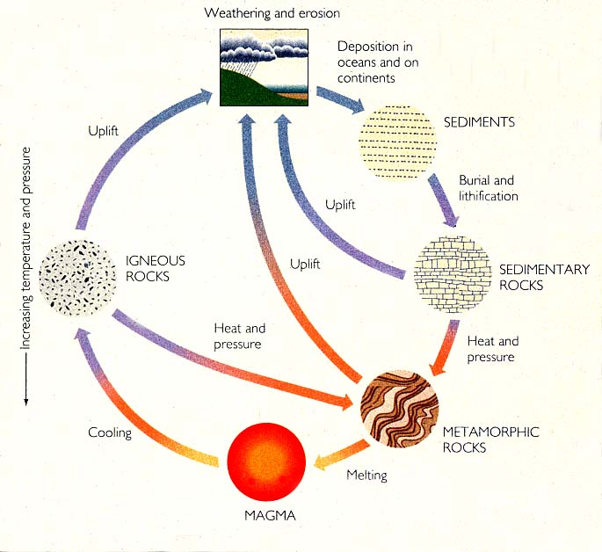
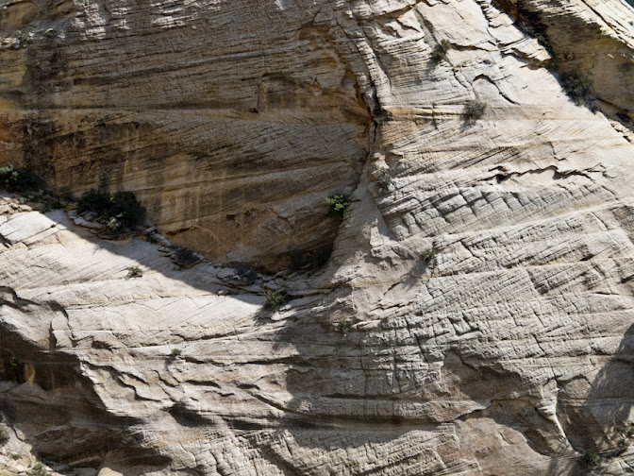
Weathering & erosion
Deposition
Sediments
Burial & lithification
Sedimentary
rocks
Navajo sandstone

Slide 9
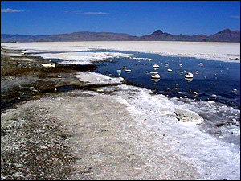
Some sedimentary rocks form by precipitating out of water
E.g. evaporating lakes precipitate salts

Slide 10
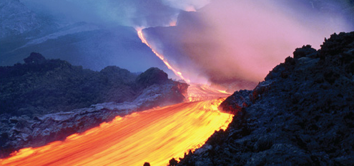
Rocks can melt
Take HOT ROCKS and:
a) Change Pressure: Decompression melting
b) Add water: Volatile-enhanced melting
c) Change Temperature: Heat transfer and melting

Slide 11
Note** magma vs. lava
Magma is molten (liquid) rock beneath Earth’s surface
Lava is magma that is on the surface
Notes:
11

Slide 12
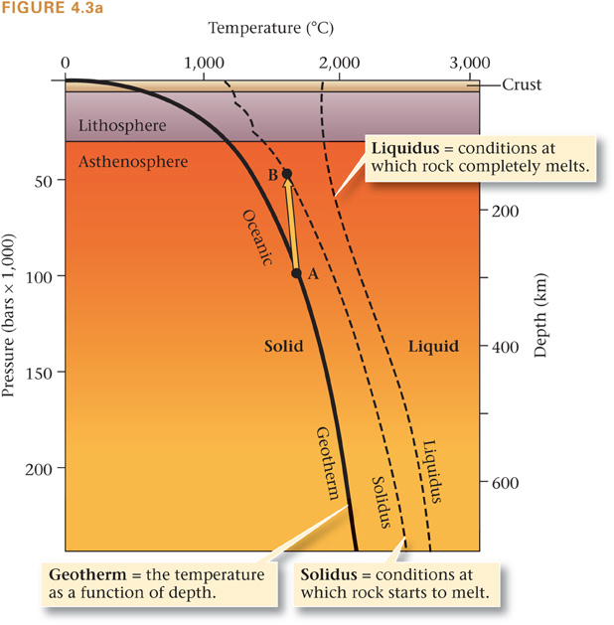
Decompression melting:
Melting b/c of a change in pressure
During decompression melting, hot rock rises from depth. As pressure decreases, the rock starts to melt.

Slide 13
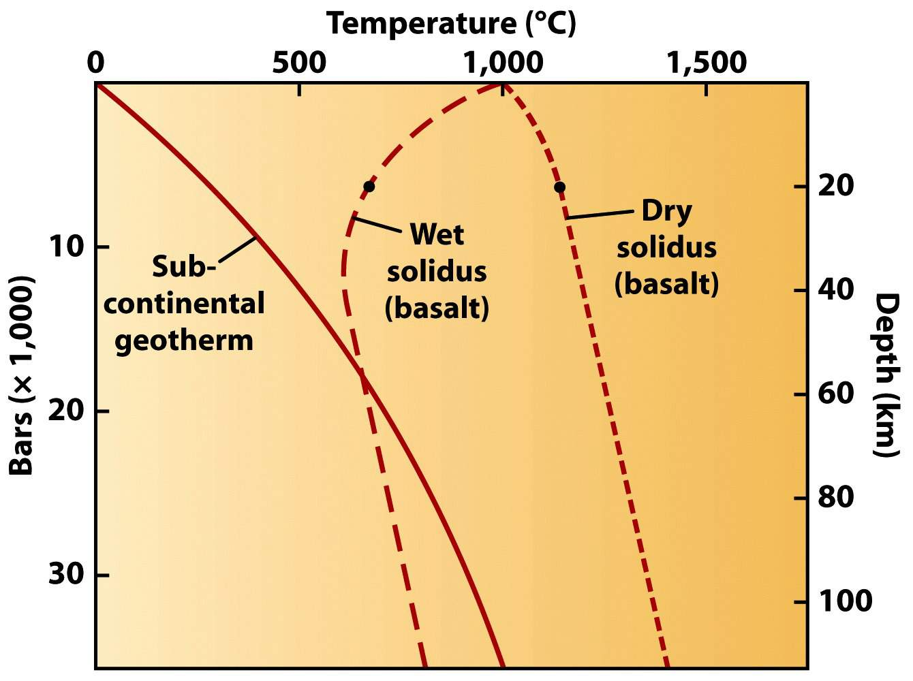
Volatiles move the solidus line:

Slide 14
Magma/lava can cool and solidify

Slide 15
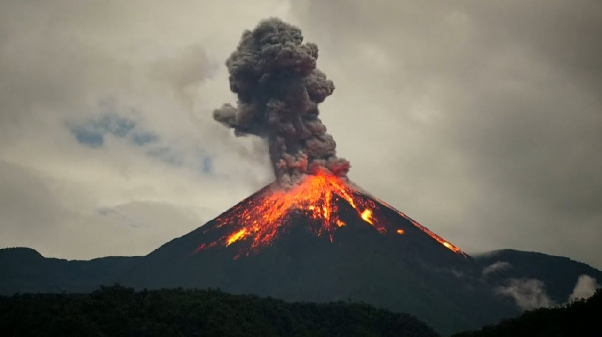
Magma can erupt at a volcano (cools FAST!)

Slide 16
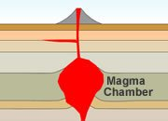
Or it can sit in a magma chamber (cool SLOW)

Slide 17
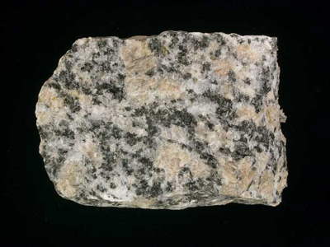
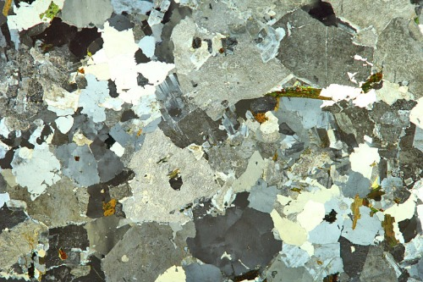
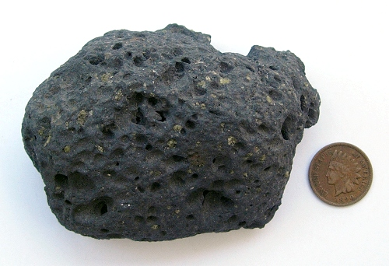
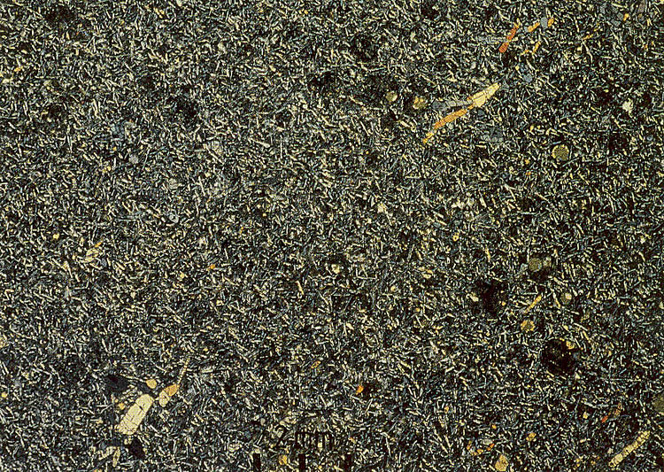
Magma/lava can cool and solidify
Igneous rocks
granite
Slow cooling – coarse grained
Cooling
Magma
basalt
fast cooling – fine grained

Slide 18
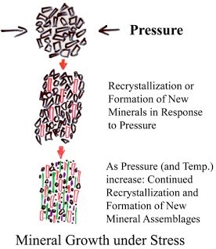
Heat and pressure can cause Ig., Sed., and Met. Rocks to transform into new metamorphic rocks
Note: this is a Solid-state transformation, i.e. NO MELTING

Slide 19
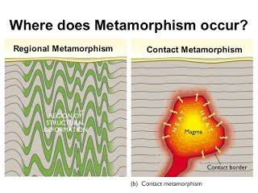
Metamorphism can occur where there is great pressure (i.e. deep below surface) or where there is great heat (i.e. rock surrounding a magma chamber)

Slide 20
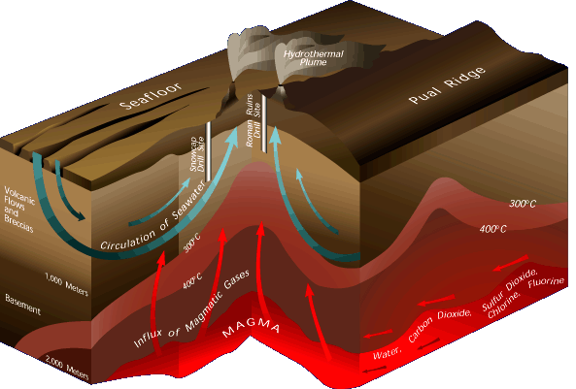
Hydrothermal Action – hot fluids move through the subsurface

Slide 21
Construct the Rock Cycle
Link the three rock types with labeled arrows representing the geologic process which “changes” one rock type into another

Slide 22
Name of all group members
Complete activity
Self select to be in the same Canvas group as your group members
One person in your group submits a PHOTO of your assignment
Part 1: DRAW - Rock Cycle figure
Part 2: LIST - key tectonic settings associated with each rock type

Slide 23
What tectonic settings are “factories” for each rock type?
Igneous
Metamorphic
Sedimentary

